Slide 1



DATA ANALYTICS INTERNSHIP
AP - LMS
In collaboration with IBM - Edunet
An Internship with a duration of 6 weeks, provided by APSCHE via AP-LMS Portal.

Slide 2

Student Detalis
Name : Krishnakalva Devendra
Roll No. : 20191A049
Class & Branch : IV B.Tech, ECE
College : JNTUA College of Engineering, Pulivendula
Domain of Internship : Data Analytics

Slide 3
Brief about the Internship
About the company IBM, Data analytics
Summary of Internship
The Learning Path
Contents
The Project
Outputs of the Project
Video of the Project
Final conclusions about the project
Certificates
External Links

Slide 4
Domain of the Internship : Data Analytics
Brief about the Internship
Company : IBM - Edunet
Internship Period : 05 - 06 - 2023 to 10 - 07 - 2023
Guide of the Internship : Smt. P.V. Kusuma
College : JNTUA College of Engineering, Pulivendula

Slide 5

International Business Machines
An American Multi - National Company
Head Quarters located at Armonk, New York
About
Services it provides :
Computer Hardware, Middleware, Software
Hosting
Consultancy services
Also some Educational services like Edunet

Slide 6

Collection, transformation, and organization of data.
Used to draw conclusions, make predictions, and drive informed decision-making.
About
Data Analytics
A large set of data from an organization can give many insights
Using that large data in a perfect manner can allow us to know many aspects of it
The process we use to get the insights from the data is called as Data analytics.

Slide 7
Learned about what is Data analytics, the IDE(Integrated Development Environment)s used for it.
The pre-recorded videos were provided for us to gain knowledge on Data analytics.
In this Internship
Completed the learning path given to us.
After getting good knowledge, we were given a common project to work on it.
The project starts with the loading and cleaning of the data given and ends with finding some useful insights from it.

Slide 8
Contains a set of chapters :
A Job Readiness Course :
How to become a Data analyst in 2023
The
Learning Path
Data Fundamentals
Introduction to Data Science
Big data foundations
Applied Data Science with Python
Enterprise Design Thinking Practitioner

Slide 9
The main objective of the project is to analyze the given dataset i.e... Doctor_visits.xlsx
The pre-recorded videos they provided helped us to gain knowledge on Data analytics.
The
Project
Steps followed in the project are:
The project requires an IDE, in this project which is Jupyter Notebook(or one can use Google Colabs).
Data should be imported into the Notebook, cleaned, derived basic information from it.
The missing values were identified and replaced with Avg. Values if necessary.

Slide 10



The main requirement to complete the project is some knowledge of Python(The latest version).
Besides the basic Python some of the modules of it are also required like :
Pillars of the
Project
Pandas
NumPy
Matplotlib

Slide 11
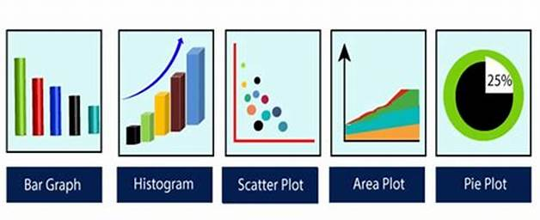
Further, the cleaned data was taken and used for plotting graphs like :
Bar Graph
Pie - Chart
Histogram
Heatmap
The
Project
Fig : Plots using python

Slide 12
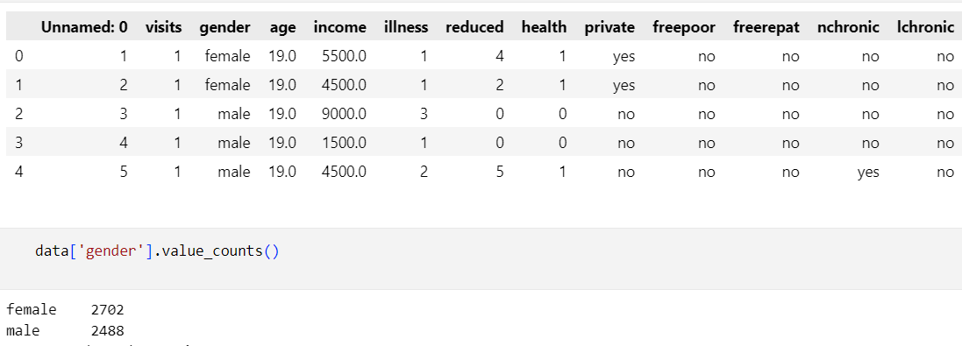
The data is loaded and made a pandas data frame.
The attributes or factors were identified.
The count of female patients is more compared to male patients.
Outputs from the Project
Fig : Loaded data from Excel sheet

Slide 13
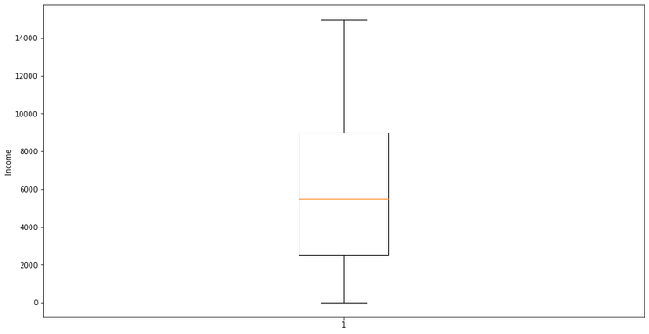
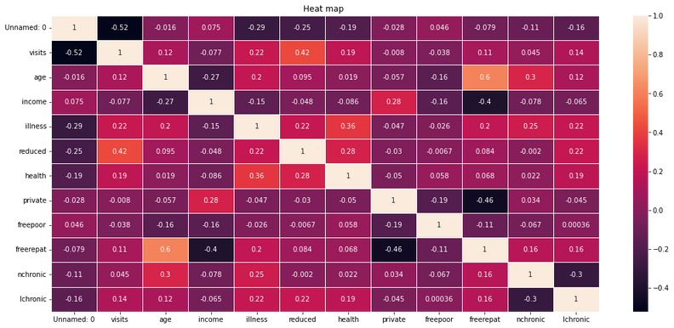
By using a Python command, the overall info. about the data was observed.
Some of the data was of Integer type, another was of float type, and some others were of boolean objects.
Converted them all to integer type without affecting the meaning and plotted some graphs.
Outputs from the Project
Fig : Boxplot
Fig : Heatmap

Slide 14
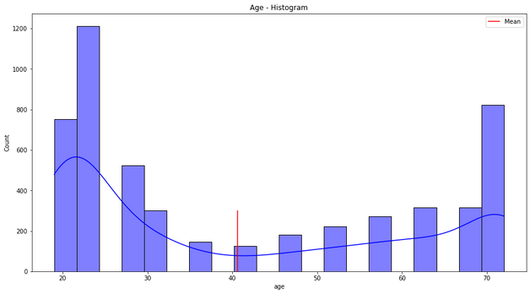
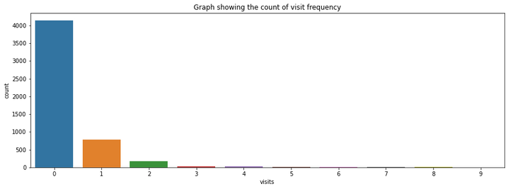
Histogram
A Histogram can be used here to find the count of people with any other parameter.
The mean age of patients is 40 years (Approx.)
And a Barplot was used to get the frequency of visits to the hospital.
Here those who visit once a week are more compared to others.
Barplot
Outputs from the Project
Fig : Histogram
Fig : Barplot

Slide 15
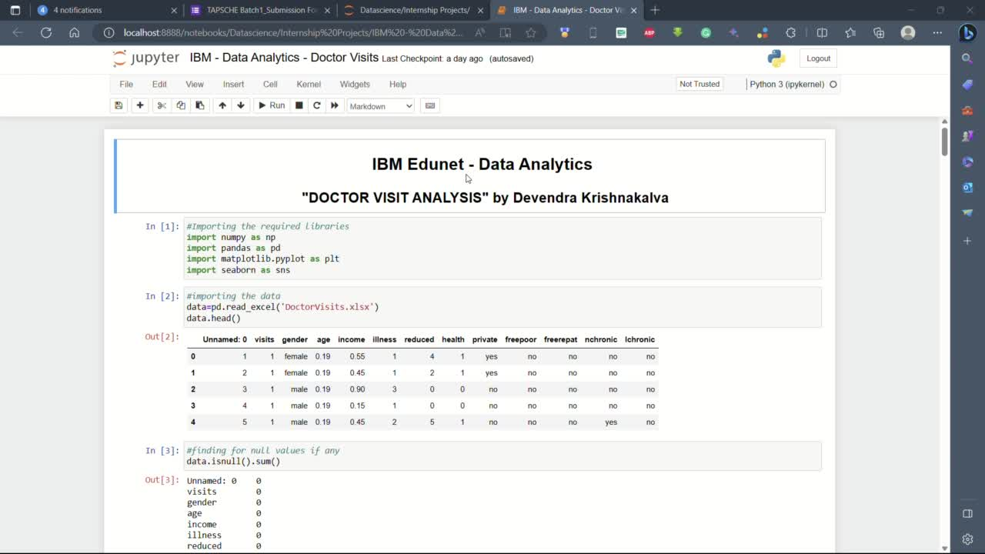
Video of the Project sourecode

Slide 16
The project is mainly helpful to the Hospital management team.
By knowing the frequency of patients waiting, management can efficiently use the doctor staff accordingly.
From the analysis, we can conclude that there are more people with private insurance compared to others.
The mean age of patients visiting the hospital is around 40 years (Approx.)
The most related attributes were ‘Income’ and ‘Free Insurance’.
And the most unrelated factors were ‘Private’ and ‘Free Insurance’ holders
Barplot gives us the frequency of visits to the hospital.
From that, we can conclude that, those who visit once a week are more compared to others.
Final conclusion
of the Project

Slide 17
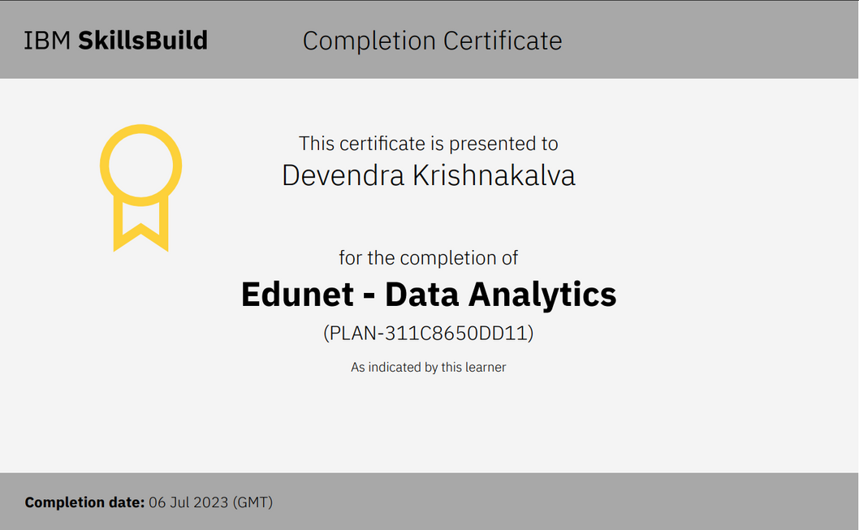
1. From IBM - Edunet :
Certificates
earned
Fig : Edunet - Data analytics certificate

Slide 18
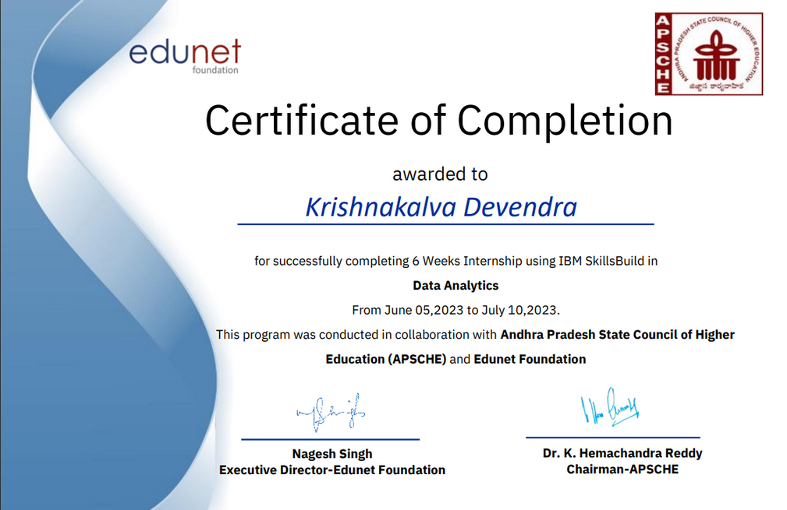
2. From APSCHE :
Certificates
earned
Fig : Certificate of completion of Internship

Slide 19
IBM Skillsbuild :
https://skills.yourlearning.ibm.com/
Drive link for ipynb file :
External Links
https://drive.google.com/drive/folders/1cR_Yfuj6UZKAO6hQCvbMcIeBzR3HZXSy?usp=sharing
Internship Certificate :
Index sheet : https://bit.ly/3PLwbSC
Certificate folder : https://bit.ly/3RMr8nx

Slide 20





